Slide 1
Multiplayer Space Simulator
MIke Boyer & Shibo Ji
COSC 729 - Spring 2020

Slide 2
Overview
Original Project Description (Goals/Features)
Implementation
Vision & Sound
Lighting
Sensors/Inputs
RPCs and SyncVars
Demo Recording

Slide 3
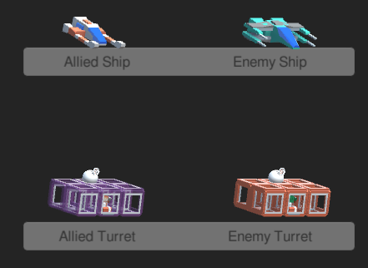
Project Description
Space Simulator:
3D Cooperative Multiplayer Space Battle (Unity 3D w/Forge Networking Remastered Framework)
Cross Platform (Tested on Linux and Windows 10)
Goals:
Upon starting a mission, players find themselves situated between two bases with allied ships (red & white) and enemy ships (green & blue) heading to them
The players must defend their allied ships and turrets (violet) while successfully defeating the enemy ships and their turrets (red)

Slide 4
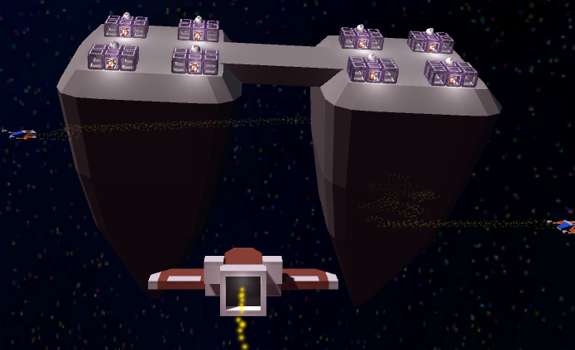
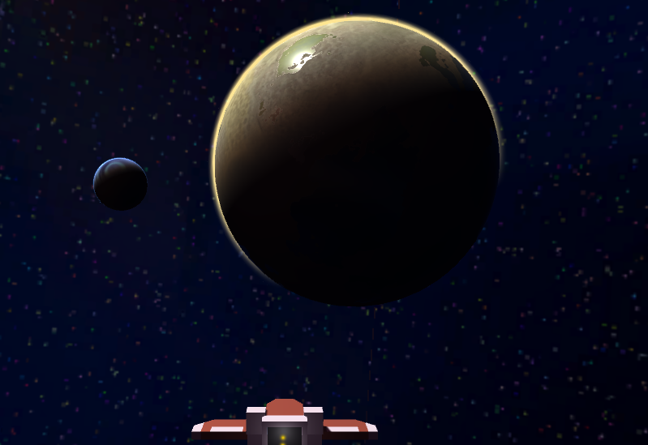
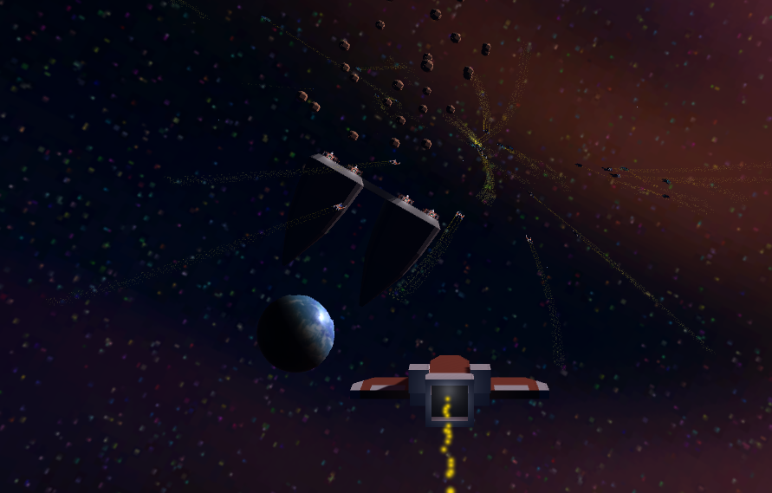
Implementation
Environment
Scenario: Space with a hand-drawn backdrop using Affinity Photo Editor
3D planets from the Unity Asset Store
Space Bases built using Blender
Turrets, ships, and other models were free assets from www.kenney.nl
Sounds used to enhance experience include laser blasts and explosions from www.kenney.nl
Space base with animated turrets and turret operators
Planets and orbiting moons
A space battle in an asteroid field

Slide 5
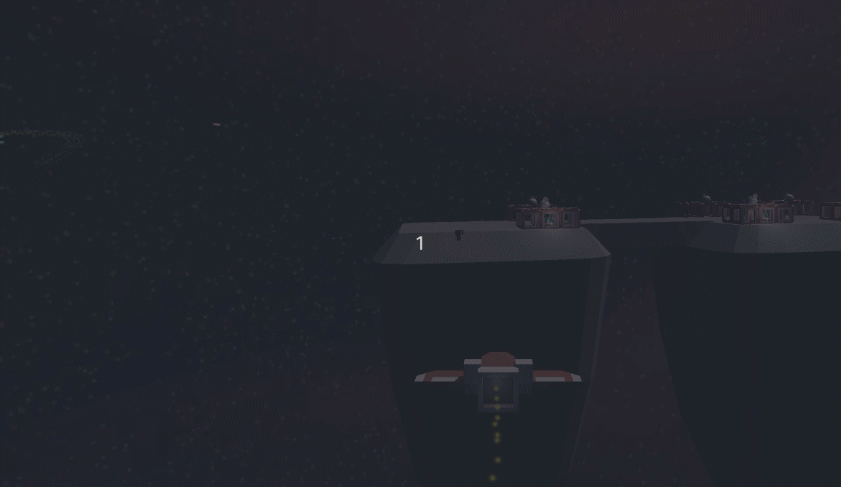
Implementation
Lighting
Directional Light to illuminate the scene
Point lights on the bases, and in the ship’s exhaust
Point lights on the lasers, colored to match the material of each laser
Green for players
Red for enemies
Blue for allies
Space base with animated turrets, lit with a combination of point and directional lighting
Planets and orbiting moons
Illuminated by Directional Light
Point lights from lasers emitting a glow

Slide 6
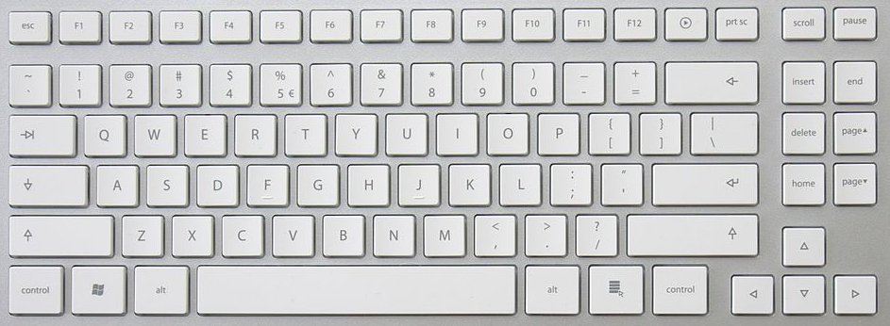
Implementation
Inputs
Inputs:
Steering - Up/Down/Left/Right (Red) either W/A/S/D or arrow keys
Speed - Z/C (Green)
Shooting - Space (Blue)

Slide 7
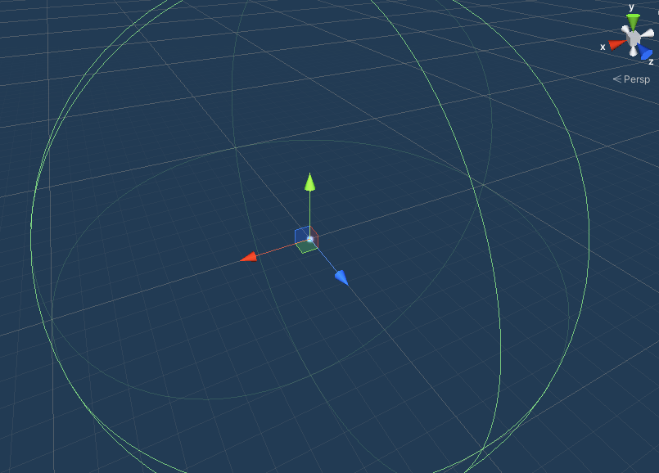
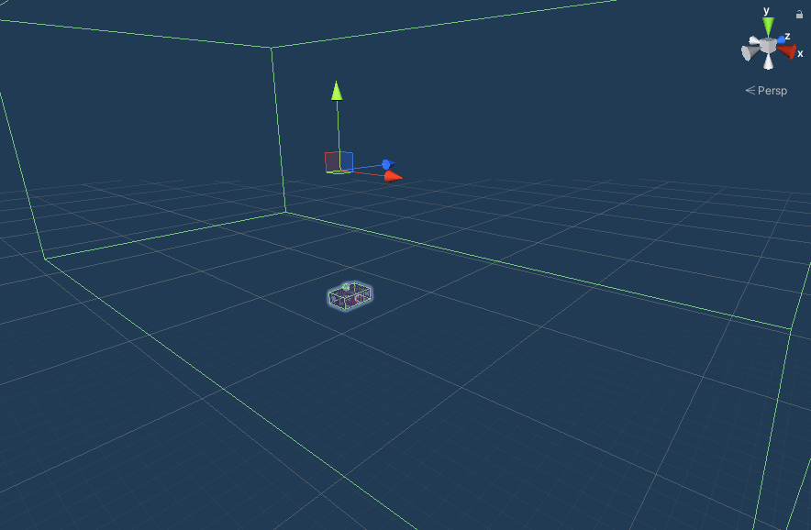
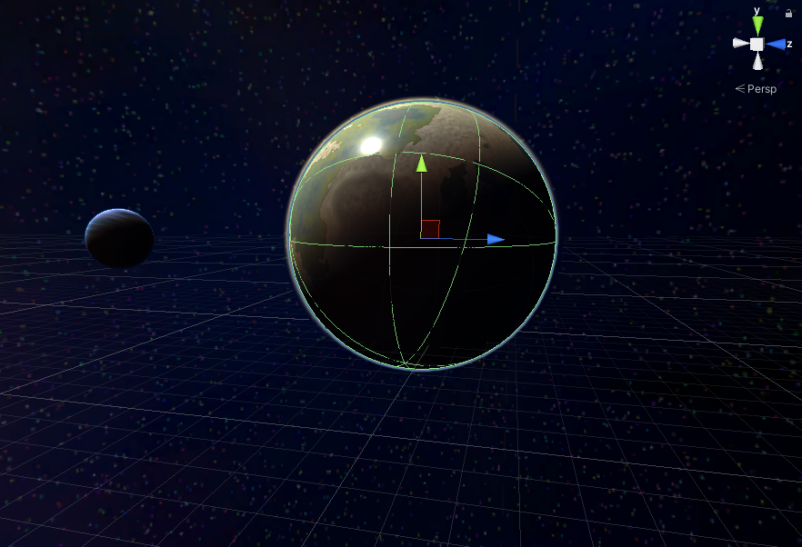
Implementation
Sensors
Sensors:
NPC Ships - Spherical Trigger-collider & Collision Avoidance via Raycast Interactions
NPC Turrets - Box Trigger-collider
Physical Objects (ships/bases/planetoids) - Rigidbody Colliders
Ship Proximity Sensor
Turret Proximity Sensor
Planet Collider

Slide 8
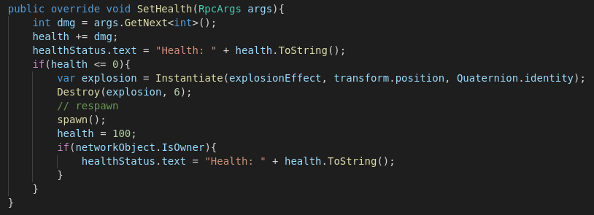
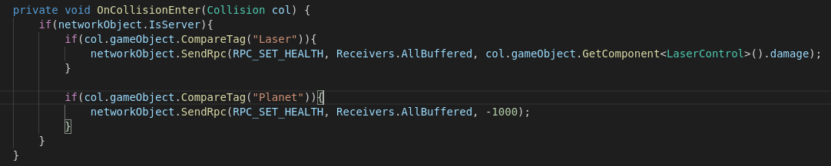
Implementation
Remote Procedure Calls (RPCs) / Synced Variables (SyncVars)
Remote Procedure Calls:
What they do
How they are used with a screenshot of SetHealth
SyncVars:
Allied/Enemy Position & Rotation
Interpolation on ship position implemented to smooth movement

Slide 9
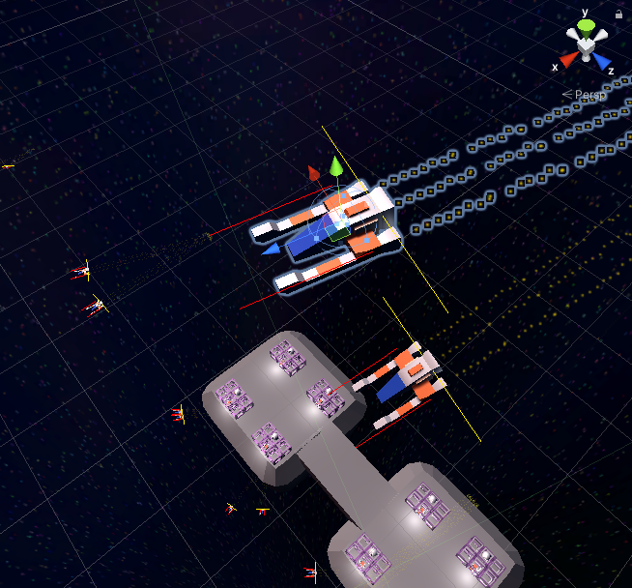
Animations
NPC Ships
Begin Scene
NPC Ship Control
Maneuvering required?
Target available?
No
NPC Ships position/rotation controlled by collision avoidance via raycasting and waypoint selection (target ship/turret or patrol coordinates)
Yes
No
Yes
Move to Waypoint
Move to Target
Enemy ship/turret w/in range?
Enemy ship/turret out of range?
No
No
Yes
Yes
Assign Target
Clear Target & Select Waypoint
Red & Yellow Rays for Collision Avoidance

Slide 10
Animations
Turret Operator
Turret Operator Panic Mode
Panic Mode Begin
Panic Mode -
Commences on destruction of the operator’s respective turret.
Result:
Pick position w/in unit sphere
Select New Waypoint
Select NavMesh Coordinates closest to position as new Waypoint
Move to Waypoint
Agent w/in specified distance to waypoint?
Yes
No

Slide 11
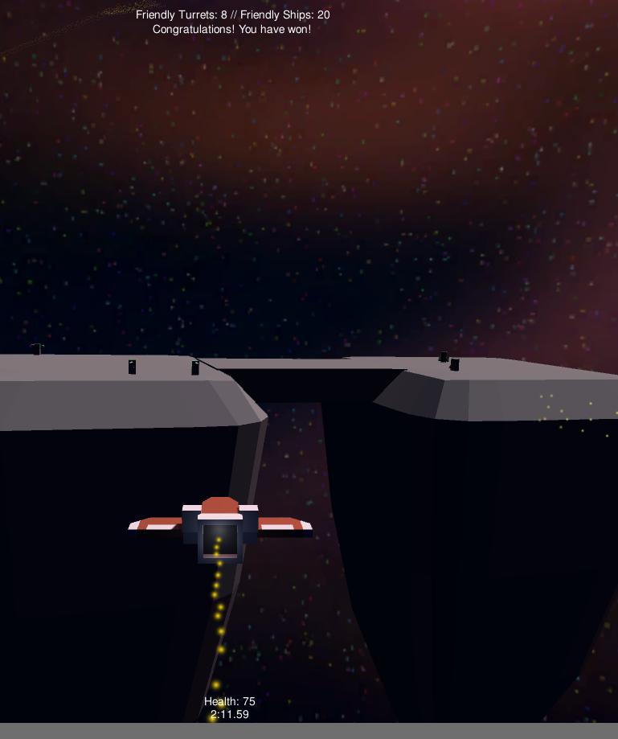
Win / Loss
Game playtime is reported below health
Upon win/loss, clock is stopped showing time to complete mission

Slide 12

Demo

Slide 13
System Requirements
Minimum:
Windows 10 - Tested with minimum system requirements and nVidia GTX 1060M processor chipset or better
Linux - Tested on Ubuntu/PopOS on 2.0 GHZ AMD A10 APU (Gen1)
Recommended:
Windows 10 - Minimum System Requirements
Linux - Ubuntu-Based distribution with an nVidia GTX 960 or better

